Slide 1
Operations Support Model: IP VOD Title-VI Traditional Entertainment + Dynamic Advertising Assets
2015 April
More up-to-date models may be on crowd documentation wiki here.
This deck contains hyperlinks.
Enter ‘presentation mode’ and click links for faster navigation.

Slide 2
Table of Contents
Mission
Structure
Escalation Model by Component
Architecture & Coverage Scope
Contact Lists for Escalations
APPENDIX
Reference Architecture
VCP Operational Oversight at Launch
Vendor Matrix by Component
More up-to-date models may be on crowd documentation wiki here.
This deck contains hyperlinks.
Enter ‘presentation mode’ and click links for faster navigation.

Slide 3
Mission
To ensure Comcast customers experience our video products as the best in the world – from individual and business subscribers to content providers and advertising partners.

Slide 4
Structure: Customer Facing vs. System Operations & Incident Management
Operations Support Model
Customer Facing
Care
( NCO / X1 COE )
Field customer calls & resolve customer issues per troubleshooting guides and tools
Escalate customer issues to Tier 2 teams as warranted (NASR)
Care Escalation
( NASR )
Work on resolution of customer issues that cannot be resolved at Tier 1
Customer communications for system wide outages that impact large customer base
System Operations &
Incident Mgmt.
Monitoring & Incident Management
Eyes on glass monitoring, incident management and escalation to resolver teams
Outage and impact communication to operation, engineering and business (nat’l & div’l)
Operations Support
& Triage
Steady state operations, e.g. config, patch, capacity management, upgrades, etc.
24/7 incident troubleshooting, triage and root cause anslysis.
SMEs
(Engineers/ Developers & Vendors)
Assist in triage of server incidents unresolvable by Ops Support teams.
Communicate with Operations teams to inform and plan for future architecture.

Slide 5
Escalation Model by Component

Slide 6
Escalation Model: VOD Asset Ingest & Asset Prep/Publishing -- Title-VI
Operations Support Model
DRAFT
Risk: In Transition due to Unified Ingest changes.
Escalation Path
Service Hosted Site | Product Function |  | Component | Care (NCO/X1 COE) | Care Escalation (NASR) | Monitoring & Incident Mgmt. | Ops Support Triage | SMEs
Broad / Potomac / Seattle | content/metadata deltas |  | Feedreader (MPX) | NCO | NASR | T&P Prod Support | thePlatform | thePlatform
 | File Delivery (video & XML) | Advertising Assets (e.g. 30 sec spots) | WatchFolder/RMPs (MPX) |  |  |  | TVX Tech Ops
 |  | Entertainment Assets (movies, shows) | WatchFolder/RMPs (MPX) |  |  | CNOC | VADER Content Engineering
 |  | content network, storage & package | CCDN, storage, JITPs
TBD | National Transcoding |  | Elemental |  |  |  |  | VADER CE & vendors
local/regional | locally ingested encode and delivery to CCDN |  | Live Cut |  |  |  | Live Cut Ops
WC, V, PO | VOD library storage (entertainment & ads) |  | Persistent Stores (“the vault”) |  |  |  | CEDAR Ops (Jason Deschanes) | Prod. Dev. Eng. (Shawn Lavelle)
DCF | File Accuracy (video & XML) | Advertising Assets (e.g. 30 sec spots) | Express Lane (video/XML & storage) |  |  |  | VADER BATMAN (SKYWALKER Dev/Ops)
 |  | Entertainment Assets (movies, shows)
 |  |  |  |  |  |  | SUMMIT (EPS: Globelnick / Calton) |  | Content Providers
n/a | Content Management | Comcast library | (business ops & project mgmt.)
 |  | VDS / Wholesale library |  | n/a | n/a
* PO = Potomac | BR = Broad Street | WC = West Chester | CH2 = Chicago | CIM = Broad Street | DCF = Dry Creek Facility | V = Vinings

Slide 7
Escalation Model: Dynamic Ad Insertion (DAI) -- Title-VI VOD
Operations Support Model
DRAFT
Escalation Path
Service Hosted Site | Product Function | Component | Monitoring & Incident Mgmt. | Ops Support Triage | SMEs
PO/BR | routes placement requests (PSNs) | Alternate Content Router | T&P Production Support | VIPER Operations | VIPER Engineering
 | signal confirmation Web Blackouts (nat’l) | Midas
 | “content info service” Signal confirmation manifest instructions | CIS
 | Placement opportunity info | POIS
 | out-of-band blackouts | ACDS Blackout
 | Route to ACDS or CIS | ESP
 | manipulates the manifest; applies logic based on signals | Manifest Manipulator (ThisTech’s VEX)
TBD | ~ | Ad SIS | TBD w/ Spotlight | TBD w/ Spotlight | Spotlight & vendors (e.g. Black Arrow)
 | ~ | SpotCom PSN
 | Campaign mgmt & Title-6 ad decision | ADS via SCTE-130-3
3rd party | blackout schedule specifics | In-band & out-of-band data | TBD | content partner engineering | content partner engineering
* PO = Potomac | BR = Broad Street | WC = West Chester | CH2 = Chicago | CIM = Broad Street | DCF = Dry Creek Facility | V = Vinings

Slide 8
Escalation Model: Video Plane
Operations Support Model
DRAFT
Escalation Path
Service Hosted Site | Product Function | Component | Care (NCO/X1 COE) | Care Escalation (NASR) | Monitoring & Incident Mgmt. | Ops Support Triage | SMEs
Potomac / Broad | Encryption key / License | CKM / DRM | NCO | NASR | T & P Production Support | VIPER Ops | VIPER / vendors
Potomac / Mt. Prospect | Load Balancer | IPVS
 | Origin | Super 8 Origin
 | Dash VOD J | Dash VOD J
 | Key Cache | Redis
 | Load Balancer | HA Proxy
 | RGB Origin | RGB JITP
 | XBOX Origin | Origin
 | XBOX Ingest server | Ingest
 | Aspera SFTP server | Aspera SFTP
 | UCS / Storage / Compute | NetApp / UCS |  |  |  | TVX Tech Ops
* Incident management for Comcast Wholesale summit team is through CNOC.
* PO = Potomac | BR = Broad Street | WC = West Chester | CH2 = Chicago | CIM = Broad Street | DCF = Dry Creek Facility | V = Vinings

Slide 9
Escalation Model: Network & ipCDN
Operations Support Model
DRAFT
Escalation Path
Service Hosted Site | Product Function | Component | Care (NCO/X1 COE) | Care Escalation (NASR) | Monitoring & Incident Mgmt. | Ops Support Triage | SMEs
network | delivery | Delivery Network (cbone/ibone) | NCO | NASR | XOC-NSD | XNOC | National NW Engg.
 |  | Local CRAN |  |  |  | XOC-CRAN / IP SSD CMTS | XNOC / Vendor
(distributed) | Delivery | ipCDN | na | na | CNOC | VADER ODOL | VADER Engineering
* PO = Potomac | BR = Broad Street | WC = West Chester | CH2 = Chicago | CIM = Broad Street | DCF = Dry Creek Facility | V = Vinings

Slide 10
Escalation Model: Control Plane Applications (1 of 3)
Operations Support Model
DRAFT
Escalation Path
Service Hosted Site ¹ | Product Function | Infrastructure/ Application Components | Care (NCO/X1 COE) | Care Escalation (NASR) | Monitoring & Incident Mgmt. | Operations Support | SMEs
X1 DCs (Potomac & Broad) | Client to Backend | XTVAPI | NCO | NASR | T&P Prod Support | App Dev (Campbell, Eggert) | App Dev (Campbell, Eggert)
 | asset metadata, media references & entitlement | MPX Web services |  |  |  | CoMPASS/MOPS | CoMPASS/Merlin (thePlatform)
 |  | Merlin Data Services
 | Discovery | XRE Server |  |  |  | XRE Dev/Ops | XRE Dev/Ops
 |  | Parental Controls
 |  | Preference Service
CH2, DC, WC |  | REX (Search) |  |  |  | CoMPASS/REX | CoMPASS/REX
 |  | Universal Resume Point Service |  |  | CNOC | VADER / UDB | CoMPASS/UDB
 |  | Availability Resolution Service (ARS)
 |  | Content Resolution Service (CRS) |  |  | T&P Prod Support | CoMPASS/MOPS | CoMPASS/Merlin
* PO = Potomac | BR = Broad Street | WC = West Chester | CH2 = Chicago | CIM = Broad Street | DCF = Dry Creek Facility | V = Vinings

Slide 11
Escalation Model: Control Plane Applications (2 of 3)
Operations Support Model
DRAFT
Escalation Path
Service Hosted Site ¹ | Product Function | Infrastructure/ Application Components | Care (NCO/X1 COE) | Care Escalation (NASR) | Monitoring & Incident Mgmt. | Operations Support | SMEs
X1 DCs (Potomac & Broad) | Scheduling | Scheduler, Quota Mgmt. Service, Device Service, etc. | NCO | NASR | T&P Prod Support | TVX Tech Ops | DVR Dev Team
 | Provisioning | XBO (Device, Provisioning, Session Services) |  |  |  |  | XBO Dev Team
DC & WC |  | Entitlement Service (UES) |  |  | CNOC-PE | VADER/UDB | CoMPASS/UDB
X1 DCs (Potomac & Broad) |  | CAM |  |  | T&P Prod Support | App Dev Team (Campbell, Eggert) | App Dev Team (Campbell, Eggert)
* PO = Potomac | BR = Broad Street | WC = West Chester | CH2 = Chicago | CIM = Broad Street | DCF = Dry Creek Facility | V = Vinings

Slide 12
Escalation Model: Control Plane Applications (3 of 3)
Operations Support Model
DRAFT
Escalation Path
Service Hosted Site | Product Function | Infrastructure/ Application Components | Care (NCO/X1 COE) | Care Escalation (NASR) | Monitoring & Incident Mgmt. | Operations Support | SMEs
Devices | IP Clients | X2 Cloud DVR Application | NCO | NASR | T&P Prod Support | CIM OPS | App Development (Sean Brown)
X1 DCs (Potomac & Broad) | Playback | License Server & Key Manager |  |  |  | VIPER Operations | VIPER (Kyong Park’s team)
 |  | Content Playback Location Services (CPLS) |  |  |  |  | Scheduler Team (Ahanger)
CMC & West Chester |  | NG-VCP |  |  | CNOC | VADER / Back Office | VADER BO / vendors
 |  | UDB |  |  |  | VSS-UDB | CoMPASS/UDB
X1 Broad DC & Regional DCs | Tools | Splunk | na | na | T&P Prod Support | TVX Tech Ops | TVX Tech Ops / vendors
* PO = Potomac | BR = Broad Street | WC = West Chester | CH2 = Chicago | CIM = Broad Street | DCF = Dry Creek Facility | V = Vinings

Slide 13
Architecture & Coverage Scope

Slide 14
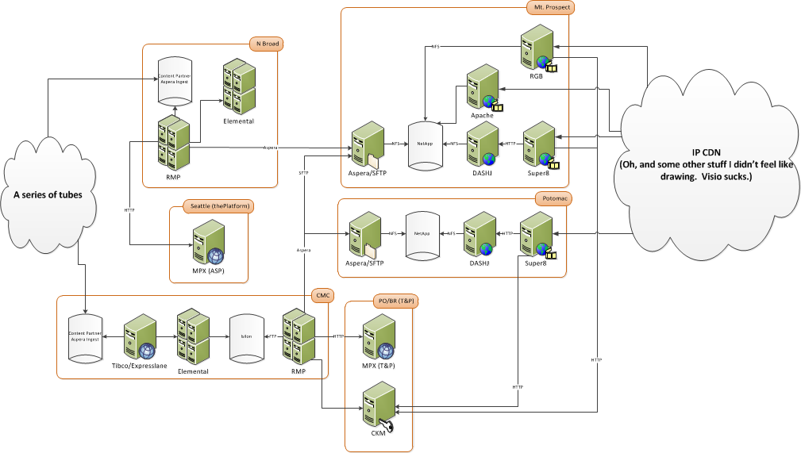
VIPER Ops’ Scope within IP VOD Architecture
VIPER Ops Scope

Slide 15
Asset Ingest Flow Links
CCDN Arch: https://wiki.io.comcast.net/display/VIDSS/CCDN+Ingest+2.0
Unified Ingest Arch: https://wiki.io.comcast.net/display/VIDSS/Uni+Architectural+Summary
CIM (thePlatform ASP): https://wiki.io.comcast.net/display/VIDSS/CIM+Ingest

Slide 16
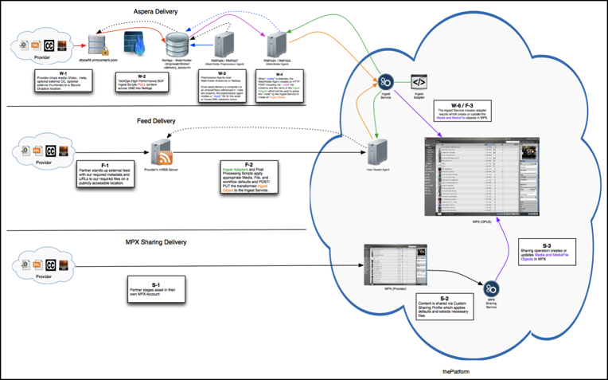
Ingest to thePlatform’s ASP (“CIM ingest”, feeding TVE/TVGo)

Slide 17
Contact Lists for Escalations
(Operations, Engineering, vendors)

Slide 18
Change Management Contacts
Team | X1 Platform CM
Lead | Phone: David Lisi Email: David_Lisi@cable.comcast.com Phone: 215-286-7226 w | 610-590-4872 c
Manager | Name: Joanne Sibony Email: Joanne_Sibony@cable.comcast.com Phone: 215-286-3166 w | 215-908-1520 c
CM Dashboard | X1 Platform CM change dashboard is here.
Team | VIPER Operations CM
Lead | Phone: Arun Karthikeyan Email: Arun_Karthikeyan@cable.comcast.com Phone: 215-286-2894 w | 301-538-6994 c
Manager | Name: Ed Waldman Email: Edward_Waldmann@cable.comcast.com Phone: 215-286-2968 w
CM Dashboard | VOPS change dashboard is here.

Slide 19
Change Management Contacts
Changes to ANY components, services, networks or systems used by IP VOD require a CHANGE ticket. (click here)
X1 cDVR Change Dashboard:
https://www.teamccp.com/jira/secure/Dashboard.jspa?selectPageId=19794
VIPER Operations Change Dashboard:
https://www.teamccp.com/jira/secure/Dashboard.jspa?selectPageId=25595
VIPER Operations Campfire:
Member: https://xcal.campfirenow.com/room/577867
Guest: https://xcal.campfirenow.com/e0fd2
Jabber:
How to join Jabber: https://wiki.io.comcast.net/display/VIDSS/Jabber+-+Connectivity

Slide 20
Comcast: T&P Production Support contacts
Escalation | Business Level | Contact Information
Level 1 | CCP Production Support Center Issue acknowledgement within 10 minutes | Main Number: 1-973-368-9502 Available 24x7x365 Send support email to ccpProd_Support@cable.comcast.com TTS Queue CCP Production Support (National Technical Operations)
Level 2 | On-Call Incident Manager | 800 601 0780
Level 3 | Sr. Mgr Production Support | Rod Bodegas Rod_Bodegas@cable.comcast.com 267 535 0431 c | 215 286 4988 w
Level 4 | Sr. Director, Production Support | Madhav Gopal Madhav_Gopal@comcast.com 856-906-9067 c | 215-286-5116 w
Level 5 | Vice President, CCP Operations | Sean Wechter Sean_Wechter@comcast.com 484 422 8333
Escalation Levels | Wait Time Before Next Escalation | Total Elapsed Time
Level 1 | 15 minutes | 15 minutes
Level 2 | 15 minutes | 30 minutes
Level 3 | 30 minutes | 1 hour
Level 4 | 30 minutes | 1.5 hours
Level 5 | 30 minutes | 2 hours
T&P Production Support escalation wiki is found here:
https://www.teamccp.com/confluence/display/xcal/Production+Support+Escalation

Slide 21
Comcast: CNOC contacts
Escalation | Business Level | Contact Information
Level 1 | CNOC-PE | CNOC-PE Toll Free: 855-837-6989 (Open Service Request – Click Here) URL below
Level 2 | CNOC-PE Service Delivery Lead | Mark Bogle (856) 792-2714 O | 610-715-3636 M Mark_Bogle@cable.comcast.com
Level 3 | CNOC-PE Manager | Maria Posada (856) 792-2673 O | 609-868-9504 M Maria_Posada@cable.comcast.com
Level 4 | CNOC-PE Sr. Manager | Jesse Prowisor, Sr. Manager | 856-952-3157 Jesse_Prowisor@cable.comcast.com
Escalation Levels | Wait Time Before Next Escalation | Total Elapsed Time
Level 1 | 15 minutes | 15 minutes
Level 2 | 15 minutes | 30 minutes
Level 3 | 30 minutes | 1 hour
Level 4 | 30 minutes | 1.5 hours
Level 5 | 30 minutes | 2 hours
Trial “Intake Team”
Escalation | Business Level | Contact Information
Level 1 | Manager | Manager1 Engineering Operation Paul Dziewisz 215-680-6066
Wiki available here.
https://wiki.io.comcast.net/display/PSC/CNOC+-+Product+Services+Center
CNOC-PE ticket URL: https://servicecatalog.cable.comcast.com/sc/catalog.product.asp?parent_category_id=&category_id=ReportIncident&product_id=CNOC_PE_OIV

Slide 22
Comcast: VIPER Operations contacts
Escalation | Business Level | Contact Information
Level 1 | VIPER Operations Team / On-Call Calendar | Team Distro: [TVX - VIPER OPS] Campfire: https://xcal.campfirenow.com/e0fd2 T&P Production On Call Calendar: https://www.teamccp.com/confluence/pages/viewpage.action?pageId=18092999
Level 2 | Director, VIPER Operations | Brian Valle Brian_Valle@cable.comcast.com M: 415-599-5763 | Dave Greenwald dave_greenwald@cable.comcast.com M: 609-634-9226
Level 3 | Sr. Director, VIPER Operations | Erik Kleinfelder Erik_Kleinfelder@cable.comcast.com M: 609-685-4448
Level 4 | Vice President, Xfinity Business Operations | Allen Broome Allen_Broome@cable.comcast.com M: 720.257.9711
Escalation Levels | Wait Time Before Next Escalation | Total Elapsed Time
Level 1 | 15 minutes | 15 minutes
Level 2 | 15 minutes | 30 minutes
Level 3 | 30 minutes | 1 hour

Slide 23
Comcast: National Video Ops (NVOC, NVDO, Titan) contacts
Escalation | Business Level | Contact Information
Level 1 | NVOC National Video Operations Center | Main Number: 303-486-3600 Available 24x7x365 Email: [CNOC_VIDEO_NVOC] <_CNOC_VIDEO_NVOC_@cable.comcast.com>
Level 2 | Assistant Managers NVOC, NVDO, Titan | NVOC - Chris Pinkerton (email) (303) 453-9743 m | (303) 712-3124 w NVDO - Jon Kirkovich (email) 303-267-5233 | 303-587-2918 Titan - Malcomb Peckham (email) 303-486-3908 | 303-944-8376
Level 3 | Senior Manager National Vidéo Distribution Operations | Charles Cannon Charles_Cannon@cable.comcast.com 303-712-3086 / 303-944-655
Level 4 | Director National Vidéo Distribution Operations | Julio Cardiel Julio_Cardiel@cable.comcast.com
Level 5 | Vice President, National Video Operations and Engineering | John Roy John_Roy@cable.comcast.com 703-486-3838 / 303 704-3253
Escalation Levels | Wait Time Before Next Escalation | Total Elapsed Time
Level 1 | 15 minutes | 15 minutes
Level 2 | 15 minutes | 30 minutes
Level 3 | 30 minutes | 1 hour
Level 4 | 30 minutes | 1.5 hours
Level 5 | 30 minutes | 2 hours

Slide 24
Comcast: SUMMIT / ESP contacts
Escalation | Business Level | Contact Information
Level 1 | CNOC-PE Support | CNOC-PE Number: 888-662-6386 Option 6 Available 24x7x365 Send support email to ODOL team via: [NETO-VSS-ODOL] <NETO-VSS-ODOL@cable.comcast.com>
Level 2 | Sr. M | Globelnick Anthony Anthony_Globelnik@cable.comcast.com 303.486.3811 W | 303.495.8783 C
Level 3 | Director, SKYWALKER | William Calton (303) 712-3090 W | (303) 901-4096 C William_Calton@cable.comcast.com
Level 4 | VP, VADER | Matt McConnell Matt_McConnell@cable.comcast.com 720-573-3236 W | 303-818-5991 C
Escalation Levels | Wait Time Before Next Escalation | Total Elapsed Time
Level 1 | 15 minutes | 15 minutes
Level 2 | 15 minutes | 30 minutes
Level 3 | 30 minutes | 1 hour
Level 4 | 30 minutes | 1.5 hours
Team coordinates content planning with Comcast’s content providers, e.g. HBO.

Slide 25
Comcast: VADER SKYWALKER & BATMAN contacts
Escalation | Business Level | Contact Information
Level 1 | CNOC-PE Support | CNOC-PE Number: 888-662-6386 Option 6 Available 24x7x365 Send support email to ODOL team via: [NETO-VSS-ODOL] <NETO-VSS-ODOL@cable.comcast.com>
Level 2 | SKYWALKER / BATMAN | Tad Bowman 303-712-3107 Tad_Bowman@cable.comcast.com
Level 3 | Director, SKYWALKER | Joe Straub (303) 267-5103 W | 303-994-4994 C Joe_Straub@cable.comcast.com
Level 4 | VP, VADER | Timojhen Mark Timojhen_Mark@cable.comcast.com 703-939-8438 W | 571-294-0545 C
Escalation Levels | Wait Time Before Next Escalation | Total Elapsed Time
Level 1 | 15 minutes | 15 minutes
Level 2 | 15 minutes | 30 minutes
Level 3 | 30 minutes | 1 hour
Level 4 | 30 minutes | 1.5 hours
Contact is maintained by these teams on their wiki. Visit this page.
Team provides ExpressLane Dev/Ops support, e.g. asset & XML health…
(both entertainment assets + dynamic advertising, DAI)

Slide 26
Comcast: VADER Content Engineering contacts
Escalation | Business Level | Contact Information
Level 1 | CNOC-PE Support | CNOC-PE Number: 888-662-6386 Option 6 Available 24x7x365 Send support email to ODOL team via: [NETO-VSS-ODOL] <NETO-VSS-ODOL@cable.comcast.com>
Level 2 | Sr. M | Scott McGill Scott_McGill@cable.comcast.com 215-286-3275 W
Level 3 | Director, SKYWALKER | Stephan David 703-939-8522 W | 571-393-0064 C Stephan_David@cable.comcast.com
Level 4 | VP, VADER | Timojhen Mark Timojhen_Mark@cable.comcast.com 703-939-8438 W | 571-294-0545 C
Escalation Levels | Wait Time Before Next Escalation | Total Elapsed Time
Level 1 | 15 minutes | 15 minutes
Level 2 | 15 minutes | 30 minutes
Level 3 | 30 minutes | 1 hour
Level 4 | 30 minutes | 1.5 hours
Contact is maintained by these teams on their wiki. Visit this page.
Team oversees successful movement and processing of VOD files (assets & XML),
e.g. RMPs & WatchFolder components for the QAM & IP product ingest.

Slide 27
Comcast: LiveCut contacts
Escalation | Business Level | Contact Information
Level 1 | CNOC-PE Support | CNOC-PE Number: 888-662-6386 Option 6 Available 24x7x365 Send support email to ODOL team via: [NETO-VSS-ODOL] <NETO-VSS-ODOL@cable.comcast.com>
Level 2 | Regional & Divisional Contacts | Contact Wiki here. https://wiki.io.comcast.net/display/VIDSS/Spotlight%2C+LIVEcut+Assets+Contacts
Level 3 | Director, SKYWALKER | Stephan David 703-939-8522 W | 571-393-0064 C Stephan_David@cable.comcast.com
Level 4 | VP, VADER | Timojhen Mark Timojhen_Mark@cable.comcast.com 703-939-8438 W | 571-294-0545 C
Escalation Levels | Wait Time Before Next Escalation | Total Elapsed Time
Level 1 | 15 minutes | 15 minutes
Level 2 | 15 minutes | 30 minutes
Level 3 | 30 minutes | 1 hour
Level 4 | 30 minutes | 1.5 hours
Contact is maintained by these teams on their wiki. Visit this page.
Team oversees successful movement and processing of VOD files (assets & XML),
e.g. RMPs & WatchFolder components for the QAM & IP product ingest.

Slide 28
Comcast: VADER ODOL contacts
Escalation | Business Level | Contact Information
Level 1 | CNOC-PE Support | CNOC-PE Number: 888-662-6386 Option 6 Available 24x7x365 Send support email to ODOL team via: [NETO-VSS-ODOL] <NETO-VSS-ODOL@cable.comcast.com>
Level 2 | Manager, Comcast ODOL | Joel McClung Joel_Mcclung@cable.comcast.com 703-939-8444 / 571-882-0617
Level 3 | Sr. Manager, Comcast VSS | Timojhen Mark Timojhen_Mark@cable.comcast.com 703-939-8438 / 571-294-0545
Escalation Levels | Wait Time Before Next Escalation | Total Elapsed Time
Level 1 | 15 minutes | 15 minutes
Level 2 | 15 minutes | 30 minutes
Level 3 | 30 minutes | 1 hour
Level 4 | 30 minutes | 1.5 hours
Contact is maintained by these teams on their wiki. Visit this page.

Slide 29
Comcast: VADER UDB contacts
Escalation | Business Level | Contact Information
Level 1 | CNOC-PE Support | CNOC-PE Number (24x7x365): 888-662-6386 → Option 6 Send support email to [NETO-VSS-UDB] <NETO_VSS-UDB@cable.comcast.com>
Level 2 | Manager, Comcast VSS-UDB | Ishaq Osman Ishaq_Osman@cable.comcast.com (703) 656-6482
Level 3 | Sr. Manager, Comcast VSS-UDB | Jaswanth Ravirala Jaswanth_Ravirala@cable.comcast.com 703-939-8459 / 703-789-3673
Level 4 | Director, Comcast VSS | Timojhen Mark Timojhen_Mark@cable.comcast.com 703-939-8438 / 571-294-0545
Escalation Levels | Wait Time Before Next Escalation | Total Elapsed Time
Level 1 | 15 minutes | 15 minutes
Level 2 | 15 minutes | 30 minutes
Level 3 | 30 minutes | 1 hour
Level 4 | 30 minutes | 1.5 hours
Contact is maintained by these teams on their wiki. Visit this page.

Slide 30
Comcast: VADER VOD Back Office contacts
Escalation | Business Level | Contact Information
Level 1 | CNOC-PE Support | CNOC-PE Number: 888-662-6386 Option 6 Available 24x7x365 Send support email to BO via: [NETO-VSS-VOD] <NETO_VSS-VOD@cable.comcast.com>
Level 2 | Manager, VSS-BO | Jason Deschenes Jason_Deschenes@cable.comcast.com 617.279.1314 Steve Tartamella Steven_Tartamella@cable.comcast.com 215.510.0059 Jeff Kukuk Jeff_Kukuk@cable.comcast.com 303.305.9925
Level 3 | Director, Comcast VSS-VBO | Jim Wilen Jim_Wilen@cable.comcast.com 215-286-5472 / 215-622-1835
Level 4 | Sr. Director, Comcast CNOC-PE | Timojhen Mark Timojhen_Mark@cable.comcast.com 703-939-8438 / 571-294-0545
Escalation Levels | Wait Time Before Next Escalation | Total Elapsed Time
Level 1 | 15 minutes | 15 minutes
Level 2 | 15 minutes | 30 minutes
Level 3 | 30 minutes | 1 hour
Level 4 | 30 minutes | 1.5 hours
Contact is maintained by these teams on their wiki. Visit this page.

Slide 31
Comcast: T&PD Software Engineering contacts
Escalation | Business Level | Contact Information
Level 1 | Sr. Manager TPD Software Engineering | Vijay Velusamy Vijay_Velusamy@cable.comcast.com 215-286-2243 O | 215-516-9465 M
Level 2 | Exec. Director TPD Software Engineering | Gulrukh Ahanger Gulrukh_Ahanger@cable.comcast.com (215) 286-2437 O | (267) 294-6362 M
Escalation Levels | Wait Time Before Next Escalation | Total Elapsed Time
Level 1 | 30 minutes | 1 hour
Level 2 | 30 minutes | 1.5 hours
Level 3 | 30 minutes | 2 hours

Slide 32
Operations Support Model
Comcast: CoMPASS / Merlin Ops & UDB Ops contacts
Escalation | Business Level | Contact Information
Level 1 | Sr. Engineer | Anthony Rubbo Anthony_Rubbo@cable.comcast.com
Level 2 | Engineer | Tim Lyons Tim_Lyons@cable.comcast.com | 201-602-0304 M
Level 3 | Manager | CRS | ARS
 |  | Jens Cahnbley Jens_Cahnbley@cable.comcast.com | Robert Rocco Robert_Rocco@cable.comcast.com
Level 4 | Director(s) | Henry DeGregorio, Dir. Merlin Henry_DeGregorio@Comcast.com (215) 286-5849 O | (609) 504-2246 M | Greg Lewis, Dir. UDB Gregory_Lewis@cable.comcast.com 215-286-8743 O | 609-217-6490 M
Level 5 | Executive Director | Jim Bracken Jim_Bracken@cable.comcast.com 215-286-8996 O | 215-327-7478 M
Escalation Levels | Wait Time Before Next Escalation | Total Elapsed Time
Level 1 | 30 minutes | 30 minutes
Level 2 | 30 minutes | 1 hour
Level 3 | 30 minutes | 1.5 hour
Level 4 | 30 minutes | 2.0 hours
Level 5 | 30 minutes | 2.5 hours

Slide 33
Operations Support Model
Comcast: CoMPASS / Rex contacts
Escalation | Business Level | Contact Information
Level 1 | On Call | On Call Engineer 202-657-5596 prodops@streamsage.com
Level 2 | Manager | John Alexander 202-281-8975 C | (202) 524-5002 W John_Alexander@cable.comcast.com
Level 3 | Director | Samarasinghe, Mevan Mevan_Samarasinghe@cable.comcast.com (202) 524-5019 M
Level 4 | Executive Director | Tom Morton Samarasinghe, Mevan 215-286-2747 O | (215) 868-5141 M
Level 5 | VP | Rick Rioboli Rick_Rioboli@cable.comcast.com 215-286-8912 O | 215-873-3276 M
Escalation Levels | Wait Time Before Next Escalation | Total Elapsed Time
Level 1 | 30 minutes | 30 minutes
Level 2 | 30 minutes | 1 hour
Level 3 | 30 minutes | 1.5 hour
Level 4 | 30 minutes | 2.0 hours
Level 5 | 30 minutes | 2.5 hours

Slide 34
Operations Support Model
Comcast: TVX Ops App Support contacts (XRE, DVR, XBO, Pandora, Traffic, etc.)
Escalation | Apps | XRE | DVR | XBO
Level 1 | T&P Production Support X1 Production Support Main Number: 1-973-368-9502 Available 24x7x365 Send support email to
Level 2 | Joe Myshko 215-806-5779 c 215.286.2881 w | Mike Muth Govind Vinjamuri | Naveed Shaik Mike Muth | Mike Muth Govind Vinjamuri
Level 3 | Marcus Yoo Tel: 215-620-0476 w
Level 4 | Vijay Velusamy Tel: 215-516-9465 c: 215-516-9465 | John McCann Tel: 215-286-4094 w (646) 723-2927 ? | Jan Paradowski Tel: | Balakrishna Kunduru Tel: ? 1st on-call: (215) 266-0607 2nd on-call: (215) 606-7709
Level 5 | Gulrukh Ahanger W: (215)286-2437 C: (267) 294-6362 |  |  | Chris Dixon W: (215) 286-5091
Escalation Levels | Wait Time Before Next Escalation | Total Elapsed Time
Level 1 | 30 minutes | 30 minutes
Level 2 | 30 minutes | 1 hour
Level 3 | 30 minutes | 1.5 hour
Level 4 | 30 minutes | 2.0 hours
Level 5 | 30 minutes | 2.5 hours

Slide 35
Tektronix contacts (video quality probes)
Escalation | Business Level | Contact Information
Level 1 | Customer Support | EMAIL: VNM-support@tektronix.com PHONE: 800-833-9200 ALT PHONE: 503-627-7111
Level 2 | Support Manager | EMAIL: xxx PHONE: xxx ALT PHONE: xxx
Level 3 | Comcast Account Manager | NAME: Rob Wiggins EMAIL: Rob.Wiggins@tektronix.com PHONE: 214.257.7827 - W ALT PHONE: 972.838.3398 – C
Level 4 | VP | NAME: Dan Donelley EMAIL: dan.donnelly@tektronix.com PHONE: (310) 985 2316– C
Level 5 | General Manager | NAME: Eben Jenkins EMAIL: eben.jenkins@tek.com PHONE: 503 627 3877 - W ALT PHONE: 971 242 9431 – C
Escalation Levels | Wait Time Before Next Escalation | Total Elapsed Time
Level 1 | 15 min | 15 min
Level 2 | 15 min | 30 min
Level 3 | 30 min | 1 hr
Level 4 | 1 hr | 2 hr

Slide 36
RGB contacts
Escalation | Business Level | Contact Information
Level 1 | Customer Support | EMAIL: support@rgbnetworks.com PHONE: 877-RGB-NETW (877-742-6389) ALT PHONE: 408-701-2800
Level x | Program Manager | NAME: Patty Miller EMAIL: pmiller@rgbnetworks.com PHONE: 214-213-9231
Level 2 | VP Customer Services | NAME: Dan Walsh EMAIL: dan.walsh@rgbnetworks.com PHONE: 408-701-2708
Escalation Levels | Wait Time Before Next Escalation | Total Elapsed Time
Level 1 | HOUR 1 | 1 hr
Level 2 | DAY 10 | 10 days
Level 3 | DAY 15 | 15 days
Level 4 | DAY 21 | 21 days
Level 5 | n/a | n/a

Slide 37
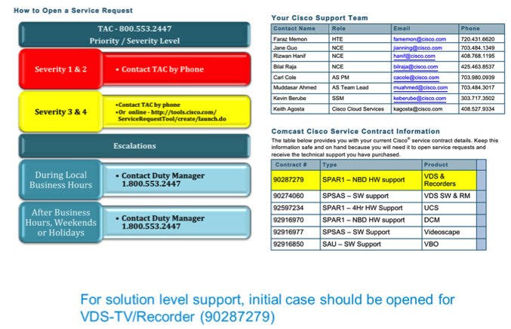
Cisco contacts

Slide 38
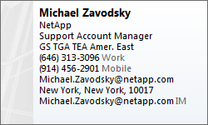
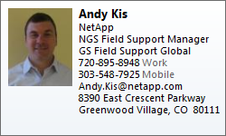
NetApp contacts
Mike Zavodsky is NetApp Service Account Manager (SAM) assigned to Comcast. The SAMs role is to be involved in all P1 and P2 cases, handle the escalation process and provide a RCA if needed.
Andy Kis who is the Field Support Manager (FSM). Andy is responsible for managing remote and on-site resources for scheduled and unscheduled tasks. Andy is in the Denver office.
NetApp Support Guide

